Slide 1
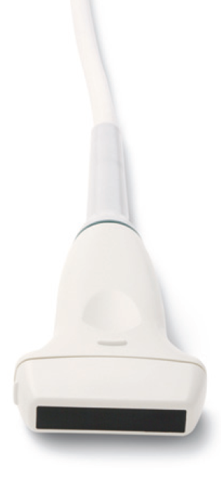
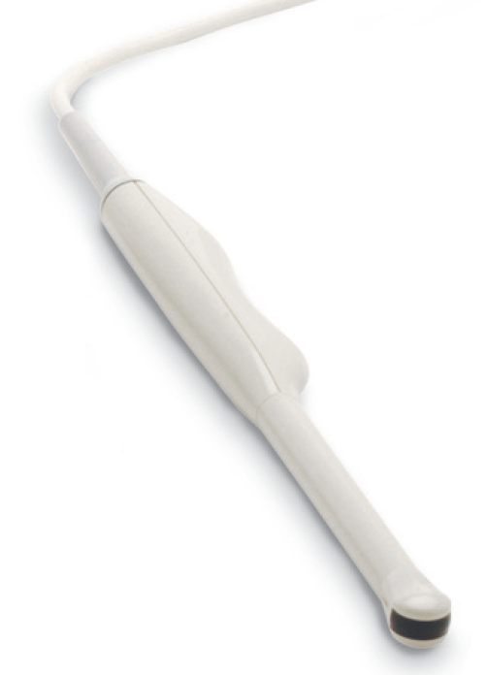
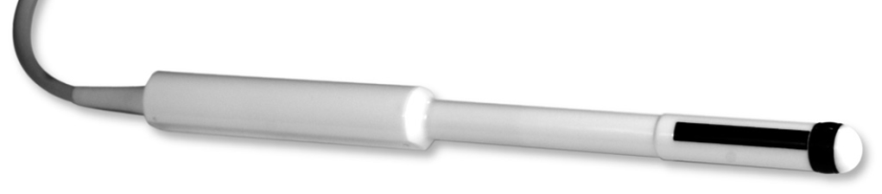
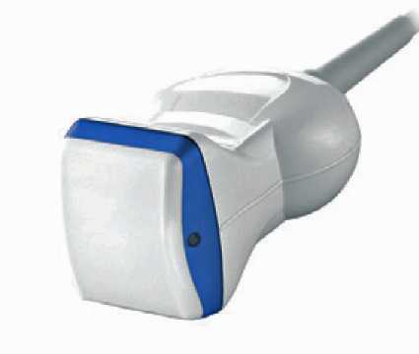
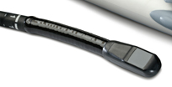
Transducer axes:
M = marked
U = unmarked = -marked
F = far
N = near = -far
A = ascending = cross(M,F)
D = descending = -ascending
For 3D probes only
N
M
U
F
F
marker
marker
M
F
M
F
M
A
F=z
M
D
A=x
M=y
F
D

Slide 2
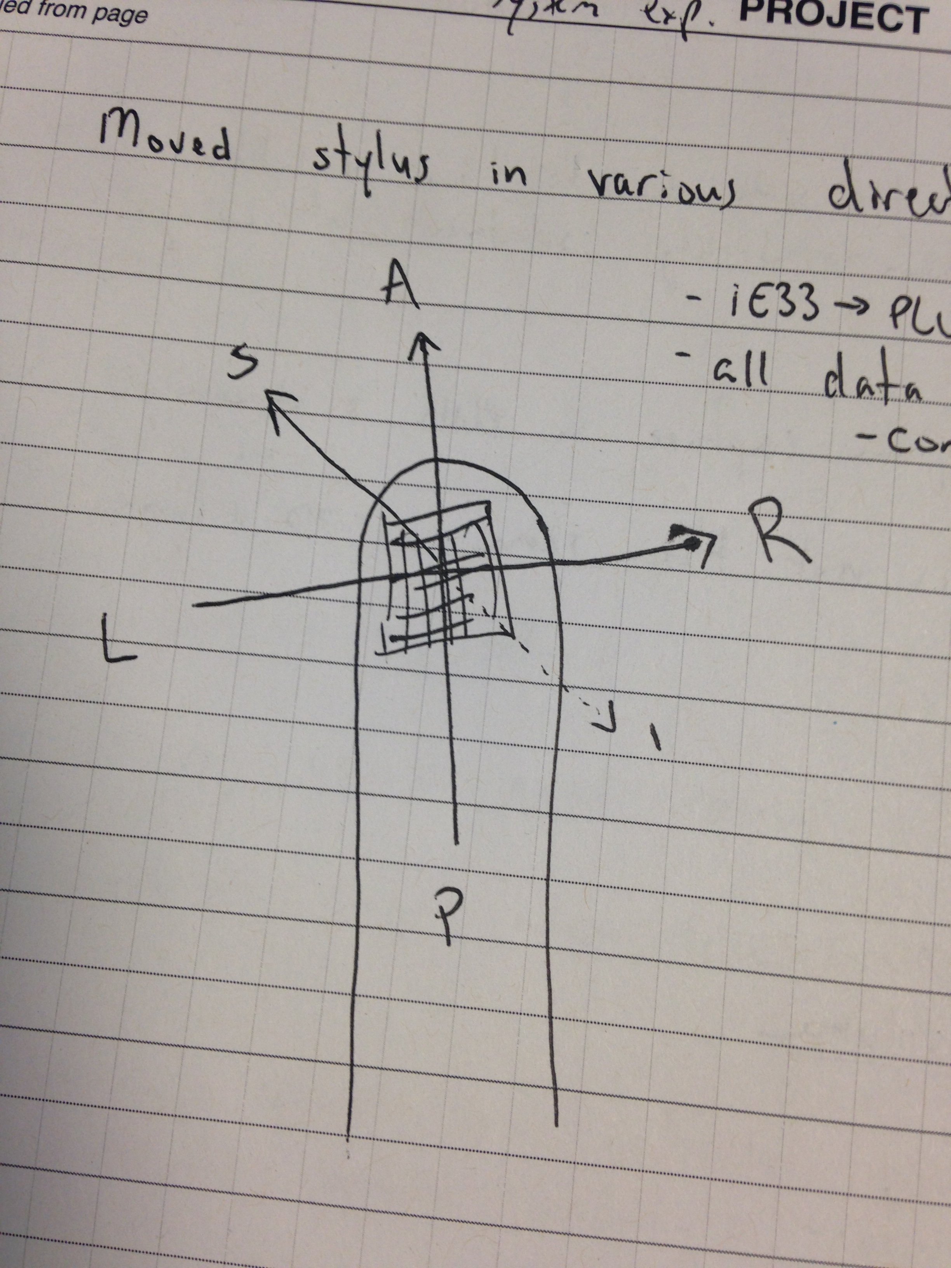
F=z
D
A=x
M=y

Slide 3
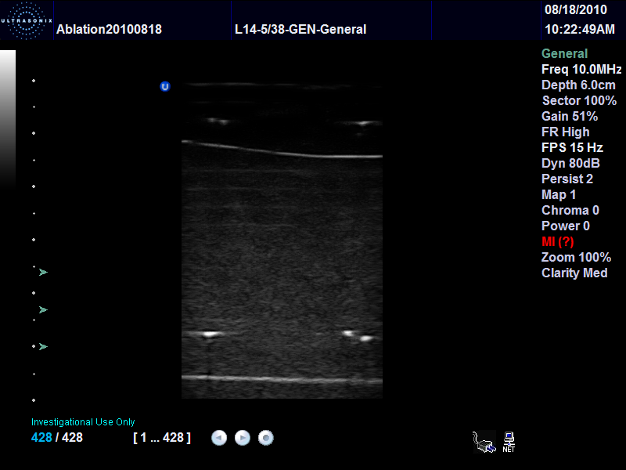
N
M
U
Marker symbol (U) is shown at the marked/near corner
F

Slide 4
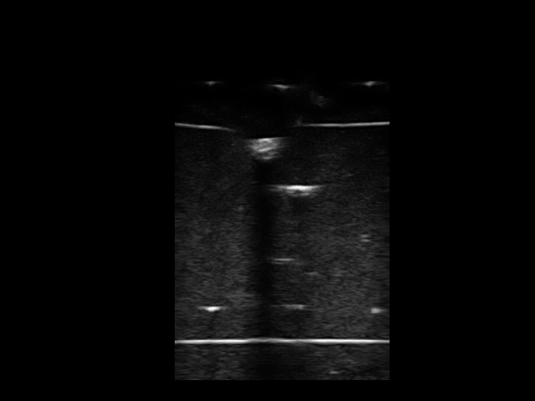
(x=0, y=0)
x direction (towards x increase)
(x=640, y=0)
N
y
(towards y increase)
M
U
F
(x=0, y=480)
(x=640, y=480)
x=U
y=F
=> UltrasoundImageOrientation = UF

Slide 5
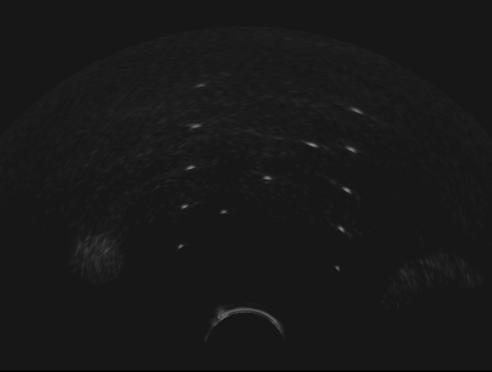
Defining clipping rectangle for volume reconstruction
F
U
M
N
ClipRectangleSize (second component) = 360 (pixels)
ClipRectangleSize (first component) = 600 (pixels)
MF coordinate
system origin
(0, 0)
Image size: 640x480 pixels
ClipRectangleOrigin = 20 40 (pixels)

Slide 6
Defining clipping fan for volume reconstruction
F
U
M
N
FanAnglesDeg[1] = -60 (deg)
FanAnglesDeg[2] = 60 (deg)
FanRadiusEndPixel = 450 (pixels)
MF coordinate
System origin
(0, 0)
FanRadiusStartPixel = 50 (pixels)
Image size: 640x480 pixels
FanOrigin = 320 40 (pixels)

Slide 7
Defining the transducer geometry for RF scan conversion - curvilinear transducer
OutputImageSizePixel[0]=820
Obsolete! (only for Plus-2.0.x)
In current versions use TransducerCenterPixel:
TransducerCenterPixel[0] = OutputImageSizePixel[0]/2
TransducerCenterPixel[1] = (RadiusStartMm –OutputImageStartDepthMm) / OutputImageSpacingMmPerPixel[1]
OutputImageSizePixel[1]=616
ThetaStopDeg = 60.0
ThetaStartDeg = -60.0
F
RadiusStopMm = 82.0
OutputImageStartDephMm = -3.0
RadiusStartMm = 10.0
(0, 0)
M
TransducerGeometry= " CURVILINEAR"
Output image size in mm = OutputImageSizePixel * OutputImageSpacingMmPerPixel

Slide 8
Defining the transducer geometry for RF scan conversion - curvilinear transducer
OutputImageSizePixel[0]=820
Plus 2.1.x and above
OutputImageSizePixel[1]=616
ThetaStopDeg = 60.0
ThetaStartDeg = -60.0
F
Transducer CenterPixel[1] = 53
RadiusStopMm = 82.0
RadiusStartMm = 10.0
(0, 0)
M
TransducerCenterPixel[0] = 410
TransducerGeometry= " CURVILINEAR"
Output image size in mm = OutputImageSizePixel * OutputImageSpacingMmPerPixel

Slide 9
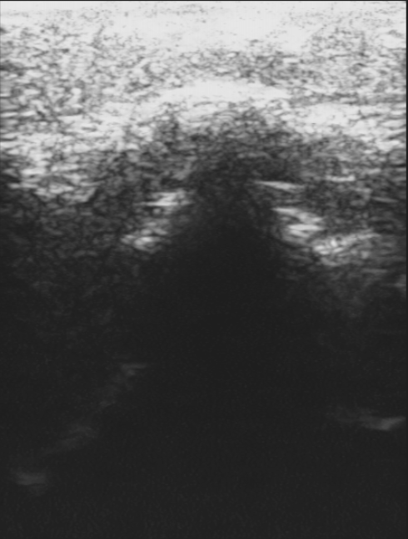
Defining the transducer geometry for RF scan conversion - linear transducer
TransducerCenterPixel[0] = 150
(0, 0)
M
Transducer CenterPixel[1] = 15
F
OutputImageSizePixel[1]=616
ImagingDepthMm = 55.0
TransducerWidthMm = 38.0
OutputImageSizePixel[0]=820
TransducerGeometry="LINEAR"
Output image size in mm = OutputImageSizePixel * OutputImageSpacingMmPerPixel

